Slide 1


Networking for Big Data Faculty of Data Science, Sapienza University of Rome Academic Year 2021-2022 Phd Student Davide Aureli
Laboratory Session, NETWORKING for BIG DATA
Prof. Antonio Cianfrani and Prof. Andrea Baiocchi
Speaker: Dr. Davide Aureli
E-mail: davide.aureli@uniroma1.it

Slide 2
Network Traffic Analysis

Slide 3
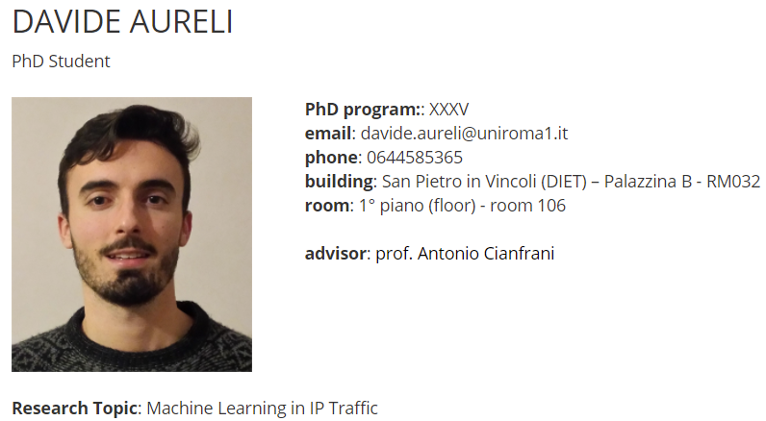
Lecturer

Slide 4
Course Organization
These Lab sessions can be divided in two typologies:
Lecture and code all together
Final Project Assignment

Slide 5
General Information
We strongly suggest you to follow the lectures with your laptop.
Every time we will observe some code part, it is better that you will try to reimplement each part of the script,
this is the only way to become more confident.

Slide 6


Group Project (HOW ?)
Group Rule: It is possible to use the groups formed with Prof. Baiocchi and Prof. Cianfrani
Presentation: each group will present the work (15 min), preparing a set of slides to comment the results

Slide 7


Group Project (WHEN ?)
All groups will have the possibility to work exploiting lesson time
During the working time in class you can ask every questions or clarification

Slide 8
IMPORTANT: Email Account
If someone is shy, just write me here: davide.aureli@uniroma1
You can update the Excel file shared at this link:
https://docs.google.com/spreadsheets/d/1j_uFCVRob_ztTos5q0N1r_YiOEXGARsB/edit#gid=310448381

Slide 9
IMPORTANT: Deadline
The project will start during class hour, and everything that is not finished will be ended by September.
The oral exam will be scheduled all together with Prof. Cianfrani

Slide 10
IMPORTANT: Material
All the material is available at:
https://github.com/davaureli/NBD_LabSession
Copy this repository !

Slide 11






Brain Storming

Slide 12

Road Map
Lecture 3
Lecture 2
Lecture 1
Project

Slide 13
Course Topics
1) Wireshark
2) PyShark
3) Machine Learning (ML) with traffic data

Slide 14
Wireshark – Lecture 1

Slide 15

From Theory to Practice
Until now you have received a theoretical explanation about Networking Fundamentals
Now it’s time to implement something from scratch

Slide 16

From Theory to Practice
Which kind of projects ?
How a Data Scientist may contribute with his knowledge ?

Slide 17
What is Wireshark ?
Wireshark is a network packet/control analyzer, available for UNIX and Windows.
Protocol analyzer that listens to the network, analyzing the data in transit, highlighting the peculiarities.

Slide 18
Intended Purposes
Observing the different analysis made within Wireshark, we take the inspiration to implement something similar for our Machine Learning Project.
But now let’s start by installing Wireshark !

Slide 19
Installation
Windows: https://www.wireshark.org/docs/wsug_html_chunked/ChBuildInstallWinInstall.html
macOS: https://www.wireshark.org/docs/wsug_html_chunked/ChBuildInstallWinInstall.html
Unix:
https://www.wireshark.org/docs/wsug_html_chunked/ChBuildInstallUnixBuild.html

Slide 20
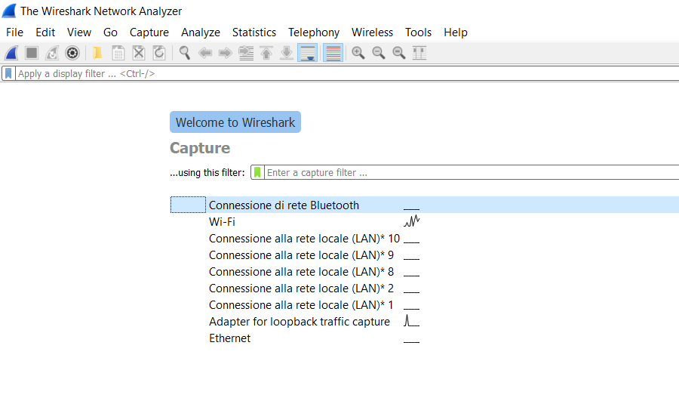
At first glance
Specify the network interface
on which to activate the capture

Slide 21
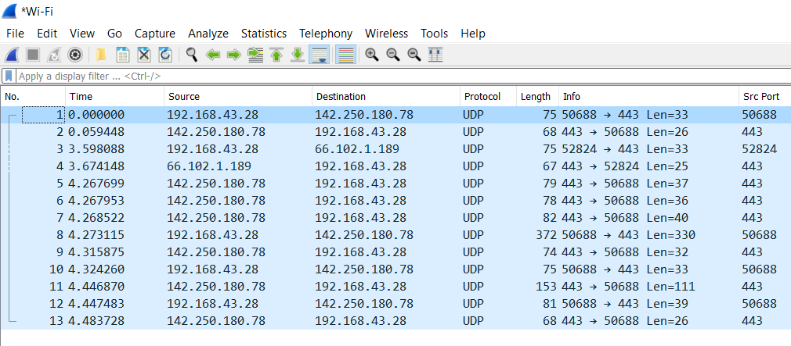
First analysis

Slide 22
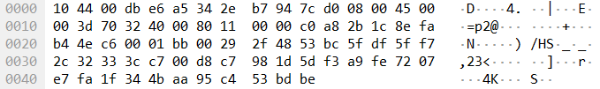
First analysis

Slide 23
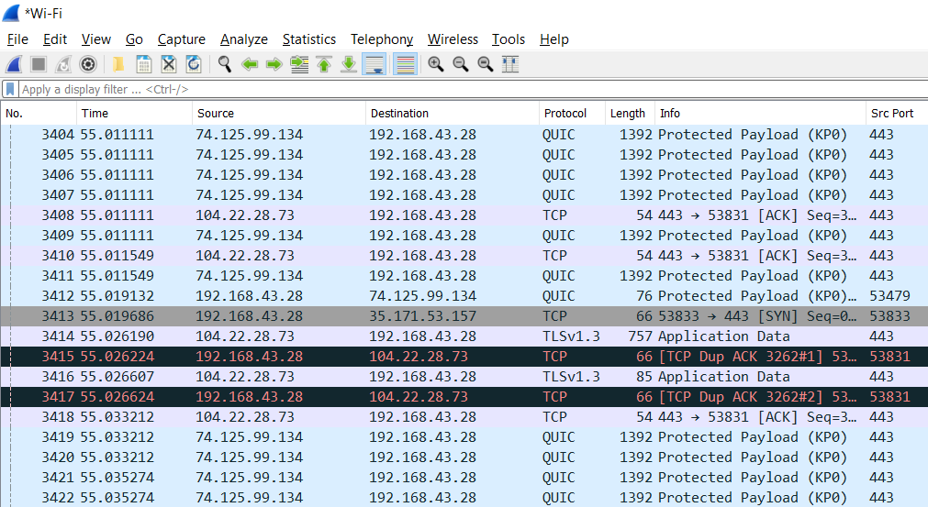
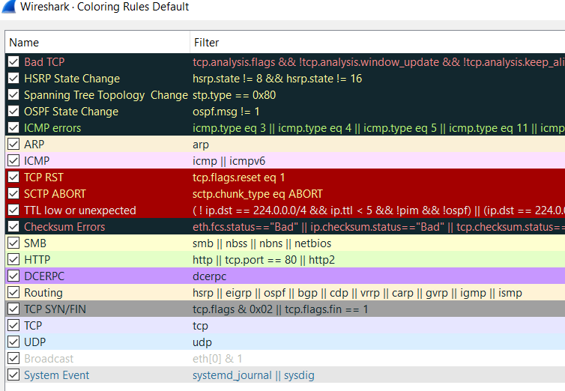
As many colors as rules
Click on → VIEW → COLORING RULES …
**We can also customize them

Slide 24
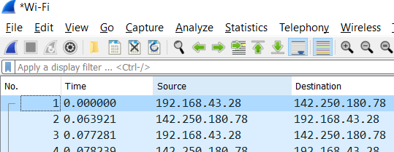
Filtering sniffed trace
Here we can apply different filters written with a precise format
(as an SQL query)

Slide 25
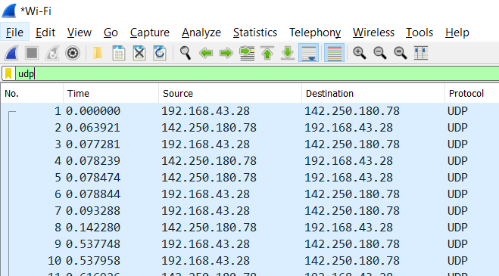
Filtering sniffed trace

Slide 26
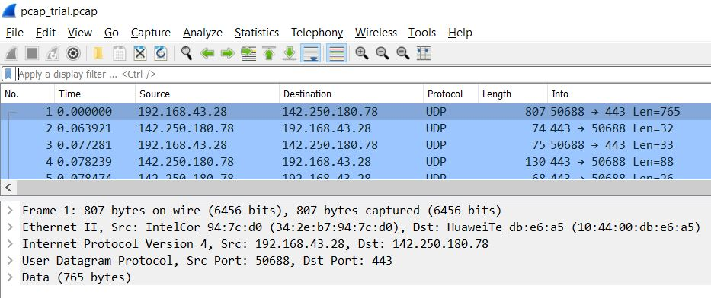
Filtering sniffed trace
Frame 807 bytes =
765 bytes Data, 14 bytes Header L2, 20 bytes IP Header,
UDP Header ? Which information ?

Slide 27
Filtering sniffed trace
1) UDP Header ? 8 bytes
2) Which information ? Src_port, Dst_port, Length, Checksum

Slide 28
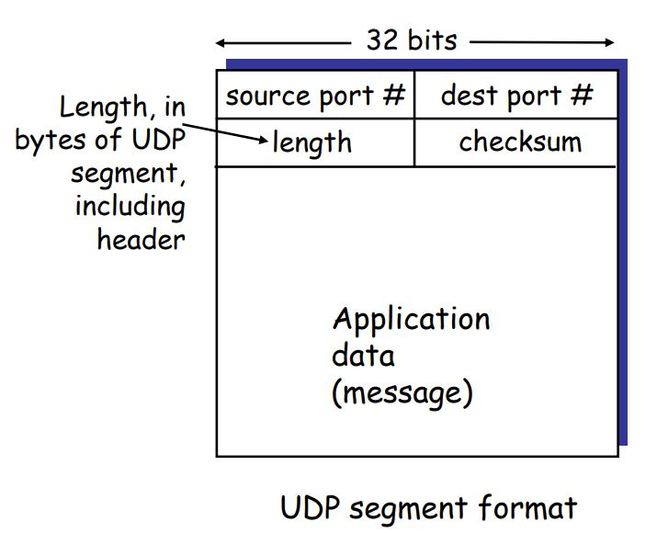
Filtering sniffed trace

Slide 29
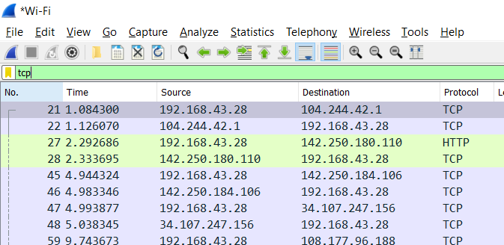
Filtering sniffed trace

Slide 30
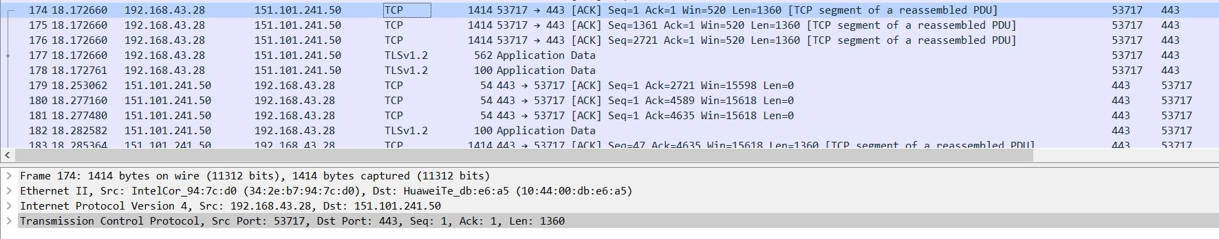
Filtering sniffed trace
Frame 1414 bytes =
1360 bytes Data, 14 bytes Header L2, 20 bytes IP Header,
20 bytes TCP Header

Slide 31
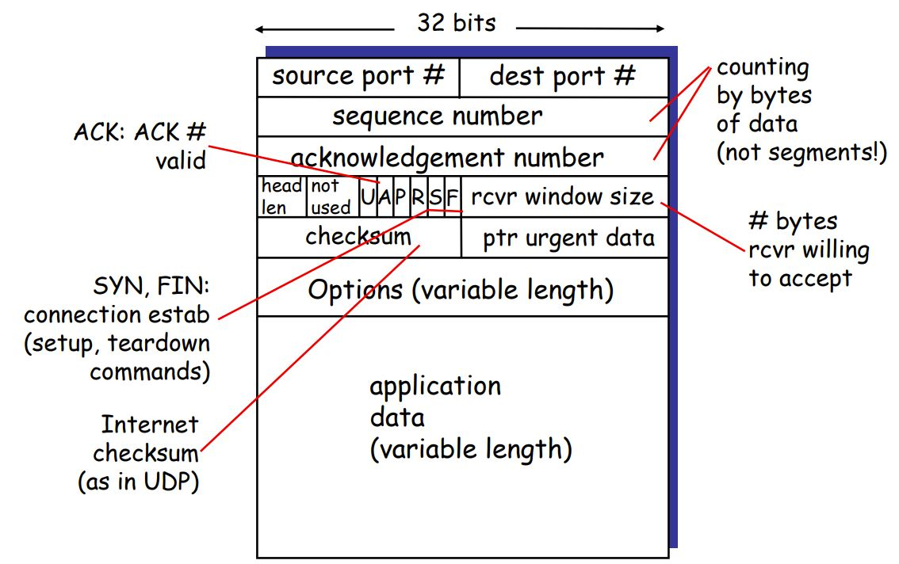
Filtering sniffed trace
TCP segment format

Slide 32
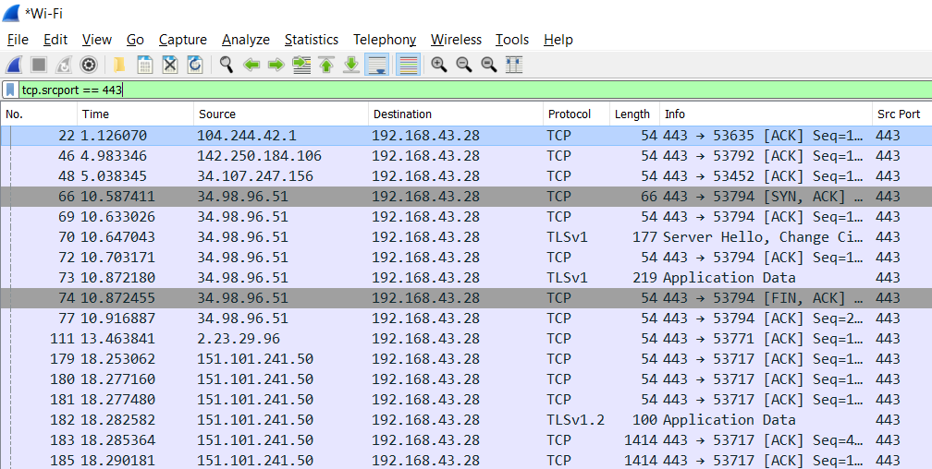
Filtering sniffed trace

Slide 33
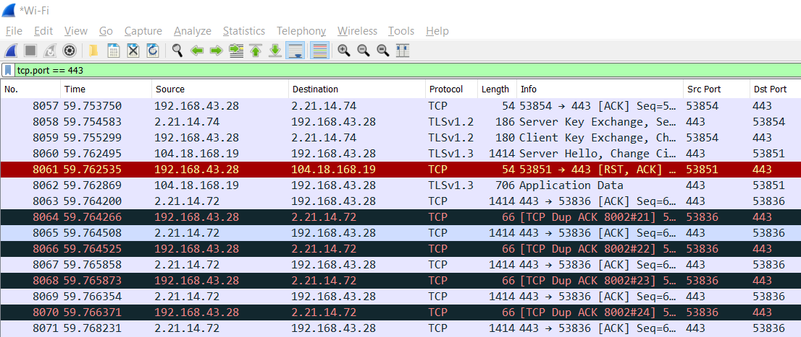
Filtering sniffed trace

Slide 34
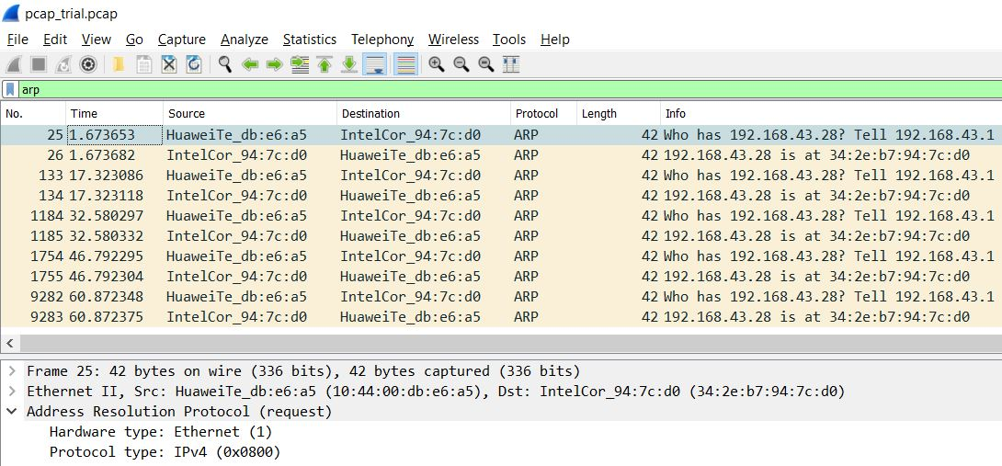
Filtering sniffed trace
ARP request

Slide 35
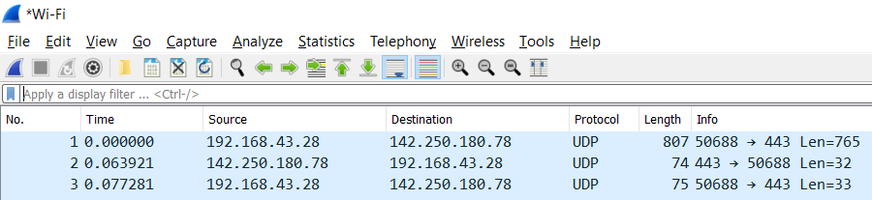
Statistics
Every time we talk about data our beloved statistics comes out

Slide 36
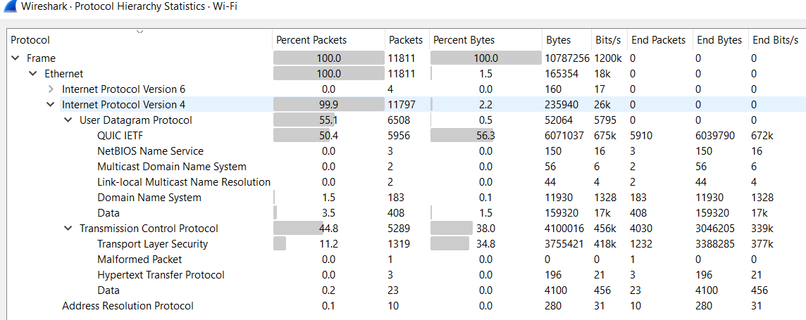
Statistics → Protocol Hierarchy

Slide 37
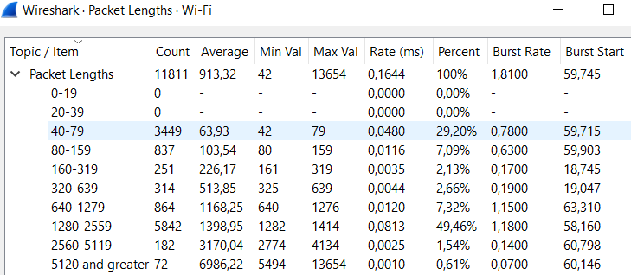
Statistics → Packet Lengths

Slide 38
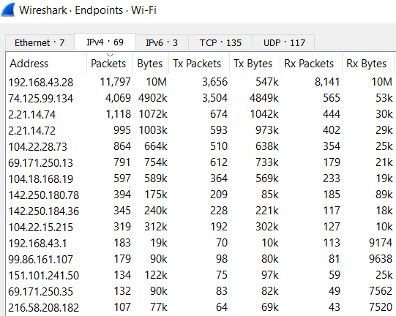
Statistics → Endpoints

Slide 39
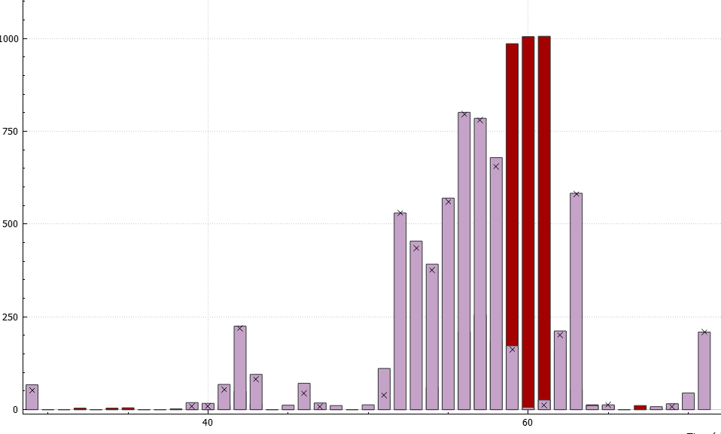
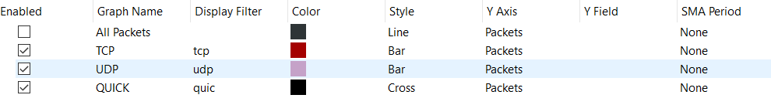
Statistics → I/O Graphs
Pkt/sec
Time(sec)

Slide 40
.pcap file
If we want to save our Packet-CAPture to reuse another time we need to save it in a pcap format.
Now, every time you will hear someone to talk about pcap file you’ll recognize it.

